Slide 1
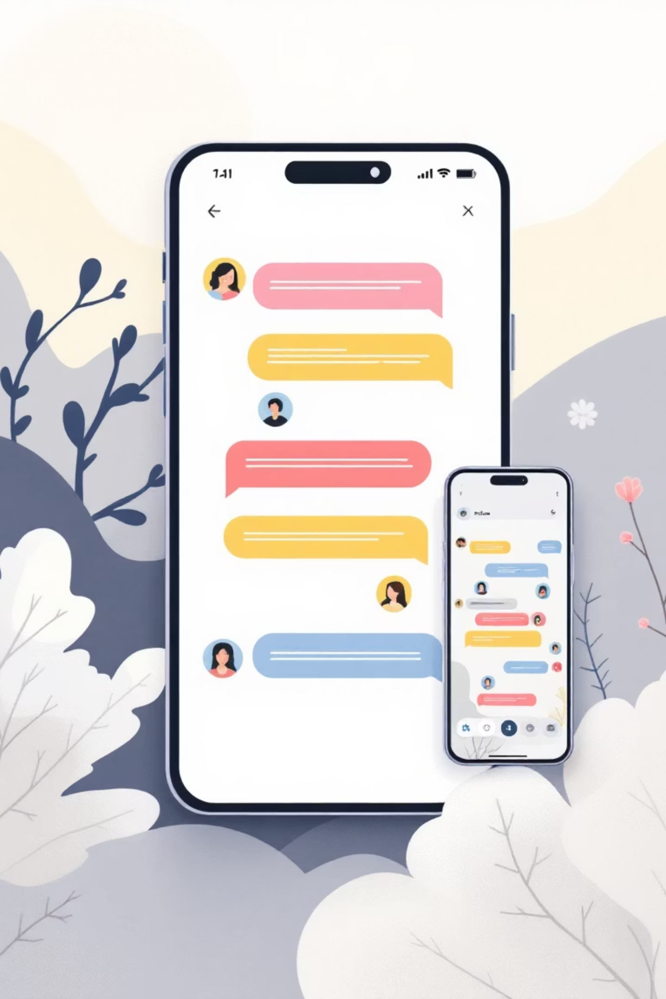
Real-Time Chat Application
A Web-Based Instant Messaging System
Presented by Himanshu Shukla, Mohit Singh, and Pandey Vivek
B.Tech Computer Science Engineering

Slide 2

Introduction to Real-Time Communication
What is a Real-Time Chat Application?
A real-time chat application enables instant, bidirectional communication between users across the internet. Messages are transmitted and displayed immediately without page refreshes, creating a seamless conversational experience.
Why Real-Time Communication Matters
Enables immediate response and collaboration
Enhances user engagement and satisfaction
Powers modern business communication
Creates connected digital communities
Industry Leaders: WhatsApp, Facebook Messenger, Slack, Discord, and Microsoft Teams have revolutionised how billions communicate daily.

Slide 3




Problem Statement
Message Latency
Lack of Instant Communication
Traditional HTTP-based systems suffer from significant delays in message transmission, frustrating users expecting instant responses.
Without persistent connections, users experience disconnected conversations and must manually refresh to receive new messages.
Real-Time Interaction Gap
Modern users demand immediate, synchronous communication that mirrors face-to-face conversations—existing solutions often fall short.

Slide 4
Project Objectives
01
02
Fast Real-Time Chat Interface
Multi-User Connectivity
Develop a responsive, intuitive interface that delivers messages instantly with minimal latency, ensuring smooth user experience across devices.
Enable multiple users to join chat rooms simultaneously, supporting dynamic conversations with seamless connection management.
03
04
Instant Message Delivery
Active User List Maintenance
Implement WebSocket technology to push messages to all connected users immediately without polling or page refreshes.
Maintain and display real-time status of online users, with automatic updates when users join or leave chat rooms.

Slide 5




Technology Stack
Frontend Technologies
HTML5: Semantic structure
CSS3: Modern styling and animations
JavaScript: Interactive functionality
Backend Technologies
Node.js: Runtime environment
Express.js: Web application framework
Socket.IO: Real-time bidirectional engine
Development Tools
Git: Version control
VS Code: Integrated development environment

Slide 6
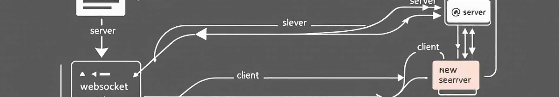



System Architecture
Client Browser
Node.js Server
Socket.IO Engine
User interface running JavaScript that initiates WebSocket connections and handles message rendering.
Express server managing HTTP requests, serving static files, and coordinating Socket.IO events.
Real-time communication layer enabling instant bidirectional data exchange via WebSocket protocol.
The architecture utilises persistent WebSocket connections for low-latency communication, falling back to polling when necessary. This ensures reliable real-time messaging across all network conditions.

Slide 7

Key Features
User Login & Room Selection
Users enter their name and choose a chat room, creating personalised, organised conversation spaces.
Real-Time Messaging
Messages broadcast instantly to all room participants with sub-second delivery times using WebSocket technology.
Join & Leave Notifications
Automatic system messages inform users when participants join or exit, maintaining conversation context.
Online Users List
Dynamic sidebar displays currently active participants in the room, updating in real-time.
Chat History (Optional)
Persistent message storage allows users to view previous conversations and maintain continuity.

Slide 8





How It Works: Message Flow
User Joins Room
User enters username and selects chat room from the login interface.
Socket Connection Established
Client initiates WebSocket connection to server via Socket.IO, creating persistent communication channel.
Message Sent to Server
User types message and submits; client emits event with message data to Node.js server.
Server Broadcasts Message
Server receives message and broadcasts it to all connected clients in the same room.
Instant Display
All users receive message simultaneously and see it appear in their chat interface without delay.

Slide 9
Thank You
Questions & Discussion
We appreciate your attention and welcome any questions about our Real-Time Chat Application project.
Project Team: Himanshu Shukla • Mohit Singh • Pandey Vivek
B.Tech Computer Science Engineering

